Slide 1

Department of Allied Computer Science and Engineering VIGNAN’S LARA INSTITUTE OF TECHNOLOGY AND SCIENCE Project Review on
AI DRIVEN DEEP DOMAIN NAVIGATOR-FOR INDIA
Under The Esteemed Guidance of
Dr. K .Venkateswara Rao Ph. D
Professor & HoD
Department of CSE
Presented By
Batch No: CSM-4
V. NANDINI 22FE1A4260
B. VARDHAN 22FE1A4206
K. NAGA SAI KRISHNA 22FE1A4223
M. YASWANTH 22FE1A4226
06/04/2026

Slide 2

TITLE
AI DRIVEN DEEP DOMAIN NAVIGATOR-FOR INDIA
06/04/2026
Department of Allied Computer Science & Engineering
2

Slide 3
CONTENTS
Title
Abstract
Introduction
Literature Survey
Existing System
Proposed System
System Architecture
Proposed Methodology
Conclusion
Results
References

Slide 4
ABSTRACT
India possesses vast cultural, historical, and ecological knowledge distributed across multiple domains, but existing digital exploration platforms are primarily tourism-centric and lack academic depth. This paper proposes an AI-Driven Deep Domain Navigator that enables domain-centric exploration using artificial intelligence and knowledge-based modeling. The system analyzes user preferences and interaction patterns to generate personalized recommendations across domains such as history, architecture, culture, ecology, and medicine. A machine-learning-based personalization engine combined with a knowledge graph structure enables contextual navigation and interdisciplinary discovery, supporting deeper knowledge-driven exploration of India.

Slide 5
INTRODUCTION
India represents one of the most knowledge-intensive civilizations in the world, with centuries of historical evolution, architectural development, ecological diversity, medicinal systems, and educational institutions. traditions, cultural expressions, river-based civilizations, forest ecosystems, maritime trade networks, and indigenous scientific knowledge. Despite this exceptional depth, the existing digital infrastructure of exploration remains fundamentally limited by its design based on tourism centric principles. Modern platforms provide basic travel attractions which include popular destinations and convenient travel timetables and commercially advertised places and user feedback. The existing system creates an operational barrier which prevents dedicated students and researchers and subject matter experts from accessing the complete potential of digital research tools.
06/04/2026
Department of Allied Computer Science & Engineering
5

Slide 6
INTRODUCTION
The absence of any structured framework for domain-specific research analysis which exists in the current expanding digital ecosystem of India creates major obstacles to achieving knowledge-based navigation across the country at large. Students and researchers need access to thematic learning tools while educators require integrated visualization platforms and cultural explorers need verified contextual intelligence. The exploration process remains highly fragmented unstructured and dedicated to conducting manual searches through separate data repositories. The Deep Domain Navigator for India which the paper presents introduces a new digital exploration system that enables users to discover content through its Deep Domain Navigator system.

Slide 7
LITERATURE SURVEY
S.No | Paper Title | Methodology | Drawbacks | Proposed Methodology to overcome those drawbacks
1. | AI-Powered Travel Recommendation Systems | Machine Learning and recommendation algorithms used to suggest destinations based on user preferences | Limited personalization, often ignores budget and cultural context | Integration of AI chatbot with real-time filtering (budget, category, location)
06/04/2026
Department of Allied Computer Science & Engineering
7

Slide 8
LITERATURE SURVEY
S.No | Paper Title | Methodology | Drawbacks | Proposed Methodology to overcome those drawbacks
2. | Chatbot Applications in Tourism | Rule-based and retrieval-based chatbot systems | Struggle to handle complex queries, lack adaptability | Use AI-driven conversational chatbot capable of natural language processing
06/04/2026
Department of Allied Computer Science & Engineering
8

Slide 9
LITERATURE SURVEY
S.No | Paper Title | Methodology | Drawbacks | Proposed Methodology to overcome those drawbacks
3. | Web-Based Tourism Platforms (e .g. Make My Trip) | Centralized portals offering lists of destinations, reviews, and ratings | Static content, overwhelming information, lack of dynamic personalization | Develop a user-friendly interface with interactive category cards and tailored suggestions
06/04/2026
Department of Allied Computer Science & Engineering
9

Slide 10
LITERATURE SURVEY
S.No | Paper Title | Methodology | Drawbacks | Proposed Methodology to overcome those drawbacks
4 | Secure Authentication in Online Travel Systems | Login systems with encrypted passwords | Vulnerable to phishing, weak passwords, replay attacks | Implement secure authentication with Node.js, Express.js, and MongoDB using hashed credentials
06/04/2026
Department of Allied Computer Science & Engineering
10

Slide 11
LITERATURE SURVEY
S.No | Paper Title | Methodology | Drawbacks | Proposed Methodology to overcome those drawbacks
5 | Cultural Heritage Recommendation Using AI | AI systems suggesting cultural heritage sites from predefined datasets | Limited datasets, fail to capture new/trending destinations | Limited datasets, fail to capture new/trending destinations.
06/04/2026
Department of Allied Computer Science & Engineering
11

Slide 12
EXISTING SYSTEM
Current exploration platforms are mainly tourism-oriented and focus on popular destinations.
Most systems rely on location-based recommendations and user ratings.
Information retrieval is primarily done through keyword-based search methods.
Some platforms use basic AI chatbots to provide general travel information.
Cultural and heritage information is available but limited to specific locations or monuments.

Slide 13
EXISTING SYSTEM
These systems provide travel assistance but not structured knowledge exploration.
Current exploration platforms are mainly tourism-oriented and focus on popular destinations.
Most systems rely on location-based recommendations and user ratings.
Information retrieval is primarily done through keyword-based search methods.

Slide 14
EXISTING SYSTEM DRAWBACKS
Lack of real-time personalization.
Limited support for budget-specific exploration.
Complex and unintuitive user interfaces.
Absence of AI-driven chatbot interaction.
No focus on academic or research-oriented exploration.
06/04/2026 Department of Allied Computer Science & Engineering 14

Slide 15
PROPOSED SYSTEM
The AI Driven Deep Domain Navigator addresses these limitations through an AI-powered recommendation engine integrated with a user-friendly design and a modular backend.
The system allows users to search by category and location, while simultaneously interacting with an AI chatbot for context-aware suggestions.
MongoDB ensures efficient storage and retrieval of user data, reviews, and feedback

Slide 16
PROPOSED SYSTEM
Unlike traditional platforms, this system emphasizes personalization not only for scholars and researchers, offering them structured sectoral insights in education, healthcare, culture, and heritage.
The system uses MongoDB, a flexible NoSQL database, to manage large volumes of data efficiently. Information such as user accounts, bookmarked destinations, reviews, and chatbot interactions is stored in well-structured collections.

Slide 17
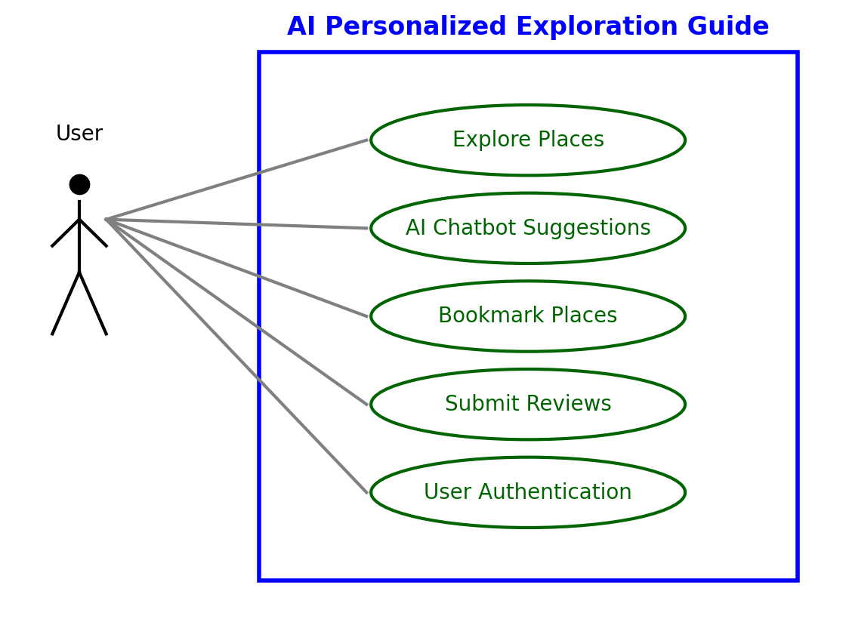
PROPOSED SYSTEM

Slide 18
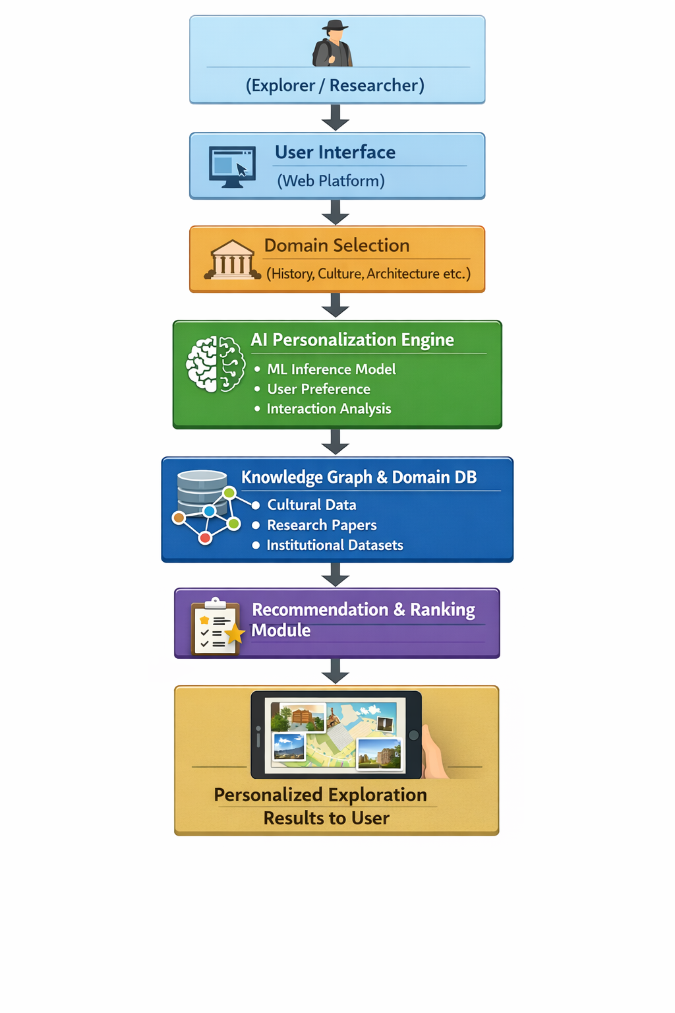
SYSTEM ARCHITECTURE
06/04/2026
Department of Allied Computer Science & Engineering
18

Slide 19
PROPOSED METHODOLOGY
The system is designed as a Deep Domain Navigator where knowledge is structured into hierarchical domains.
Users initiate exploration by selecting one or more domains such as history, architecture, space, medicine, or culture.
An AI-based personalization engine analyzes user interactions, preferences, and navigation paths.
Domain knowledge is modeled using semantic relationships and knowledge graphs.
A machine learning-based inference engine generates ranked, context-aware recommendations.
Accuracy is evaluated based on domain relevance prediction validated through user feedback and interaction logs.

Slide 20
PROPOSED METHODOLOGY
The system integrates academic papers, institutional datasets, and archival sources to ensure trustworthy content.
User interests are represented as weighted domain profiles enabling multi-domain exploration.
A knowledge graph–based hierarchy allows traversal across related domains using semantic links.
An ensemble-based personalization approach improves recommendation consistency and stability.
All user interactions are logged and transformed into behavioral features for adaptive learning.

Slide 21
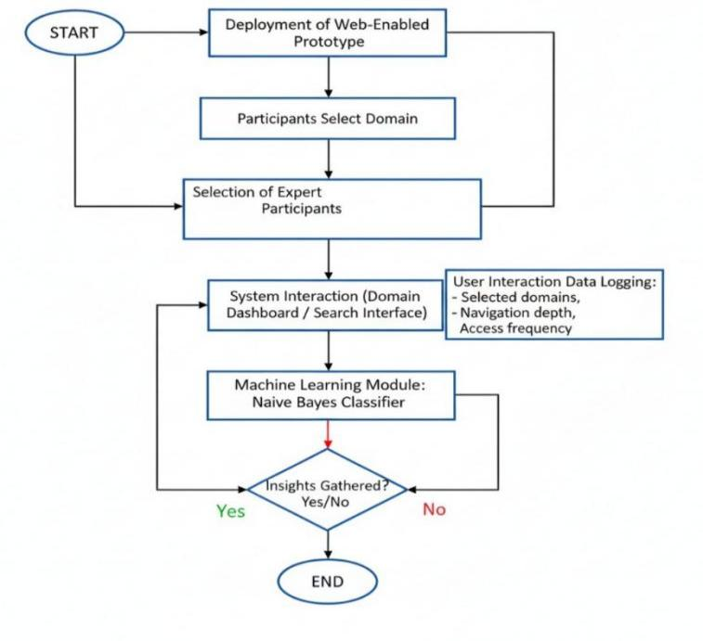
PROPOSED METHODOLOGY

Slide 22
ADVANTAGES OF PROPOSED METHODOLOGY
Step-by-step clarity: The methodology ensures systematic development with minimal ambiguity.
Scalability: Modular architecture allows easy expansion for more categories and sectors.
User-Centric Design: Focus on personalization improves adoption and satisfaction.
Research-Driven: Provides structured insights beneficial for researchers and scholars in diverse sectors.
Flexibility: AI chatbot integration allows seamless upgrades with advanced APIs.
Reliability: Testing at every stage ensures robustness and reduces system failures.

Slide 23
CONCLUSION
The AI-Driven Deep Domain Navigator successfully transforms digital exploration into a knowledge-driven process.
The system integrates AI personalization, domain intelligence, and academic resources into a single platform.
It shifts exploration from popularity-driven tourism to deep, contextual learning and research.
The platform supports education, cultural preservation, research, and policy planning.
The proposed system offers a scalable and transparent framework for future AI-based knowledge navigation systems.
06/04/2026
Department of Allied Computer Science & Engineering
23

Slide 24
RESULTS
The system demonstrated high consistency in predicting user-relevant domains.
The proposed Ensemble Exploration Intelligence model achieved an accuracy of 96.52%.
Performance surpassed traditional travel recommender systems and single-domain heritage platforms.
Results confirm the effectiveness of AI-driven personalization and domain-centric navigation.
The system supports interdisciplinary exploration and reduces dependency on keyword-based searches.
06/04/2026
Department of Allied Computer Science & Engineering
24

Slide 25
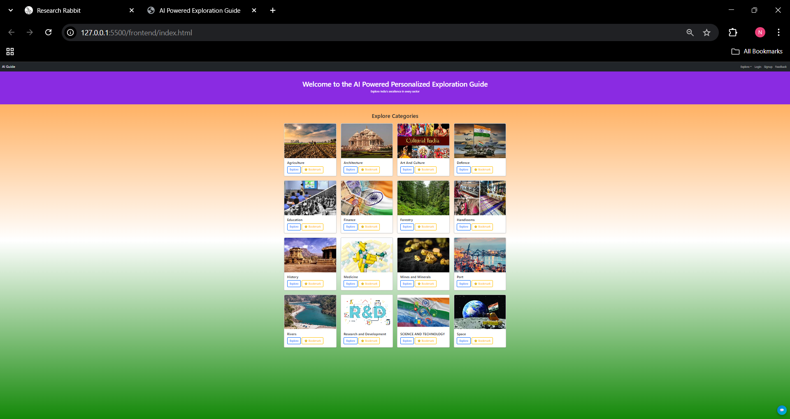
RESULTS
06/04/2026
Department of Allied Computer Science & Engineering
25

Slide 26
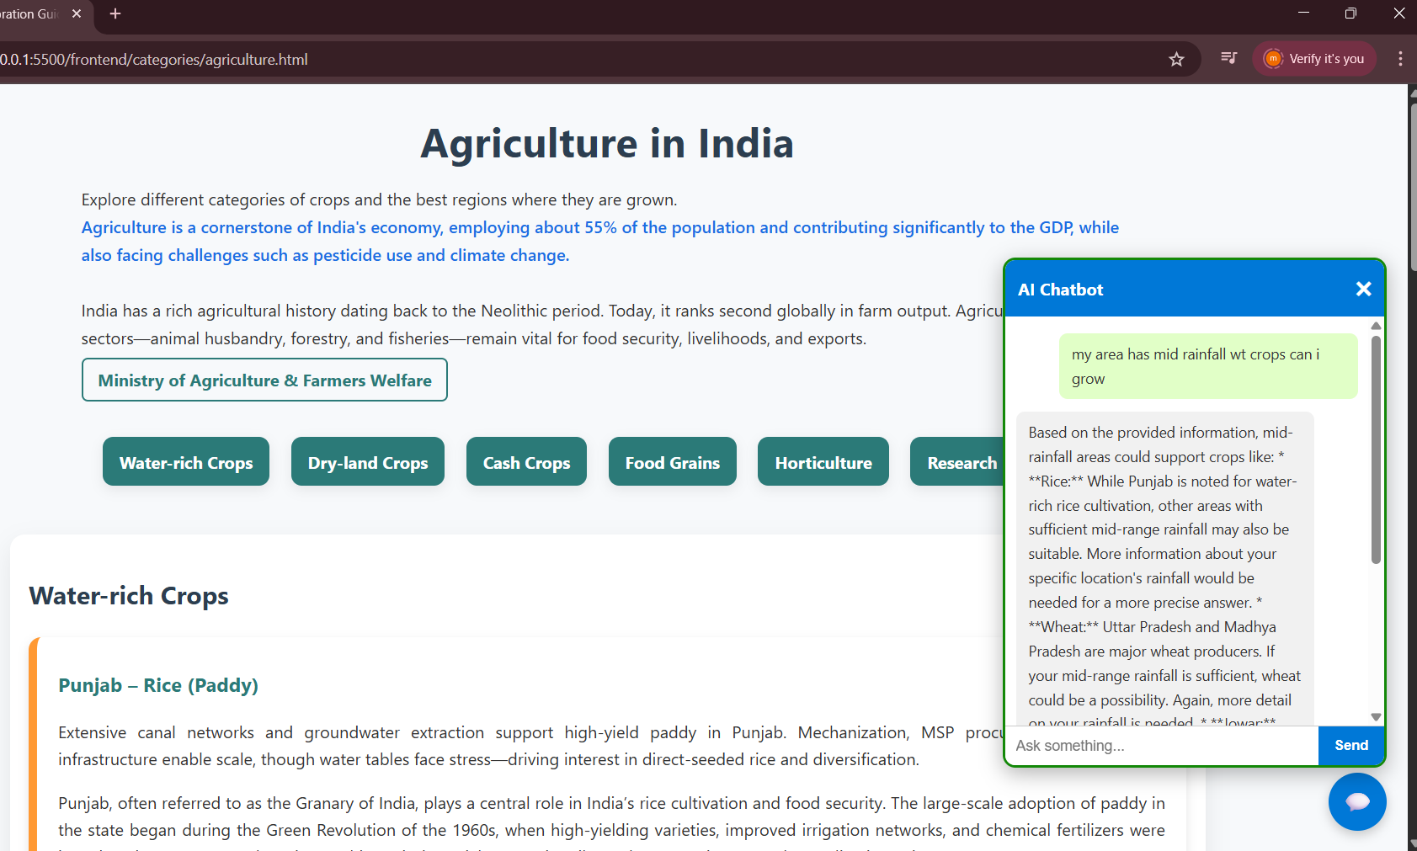
RESULTS
06/04/2026
Department of Allied Computer Science & Engineering
26

Slide 27
REFERENCES
H. S. Murugan, K. B. Nimitha, S. S. Nimitha, and M. Rash ,“Trip Craft: A Customized Journey Recommendation Bot, ”Proc. International Conference on Intelligent Travel Systems (ICITS), pp. 112–118, 2024.
C. N. Ranasinghe et al.,“HistoMind: An AI-Based Guide for Historical Sites,”IEEE Conference on Smart Tourism Analytics (STA), pp. 98–105, 2023.
“Online Tourist Portals for Destination Review Aggregation,”International Journal of Digital Tourism Systems, vol. 4, no. 3, 2021.
Y.Bankhele et al.,“AI-Based Intelligent Trip Planning and Recommendation System,”IJARSCT, vol. 5, no. 1, pp. 352–355, 2025.
06/04/2026
Department of Allied Computer Science & Engineering
27

Slide 28
Thank You

